Slide 1
Employee data analysis using Excel
Student name: Radha Kushwaha.J
Register number:422200509
NMID:9B6BA6DC8FBBB83B8D74A4DA349FB395
DEPARTMENT: B.COM(ISM)
COLLEGE NAME: Valliammal college for women

Slide 2
Project title
Employee performance analysis using Excel

Slide 3
Agenda
Problem statement
Project overview
End users
Our solution and proposition
Data description
Modelling approach
Result and discussion
Conclusion

Slide 4
Problem statement
Analyzing employee performance enables organization to optimize productivity by ensuring that employees are working efficiently and effectively towards their goals.

Slide 5
Project overview
Analyzing the salary of the employee by considering various factors like gender, employee ID, start date, employee type, department etc. different categories of employee salary like very high , medium and low.

Slide 6
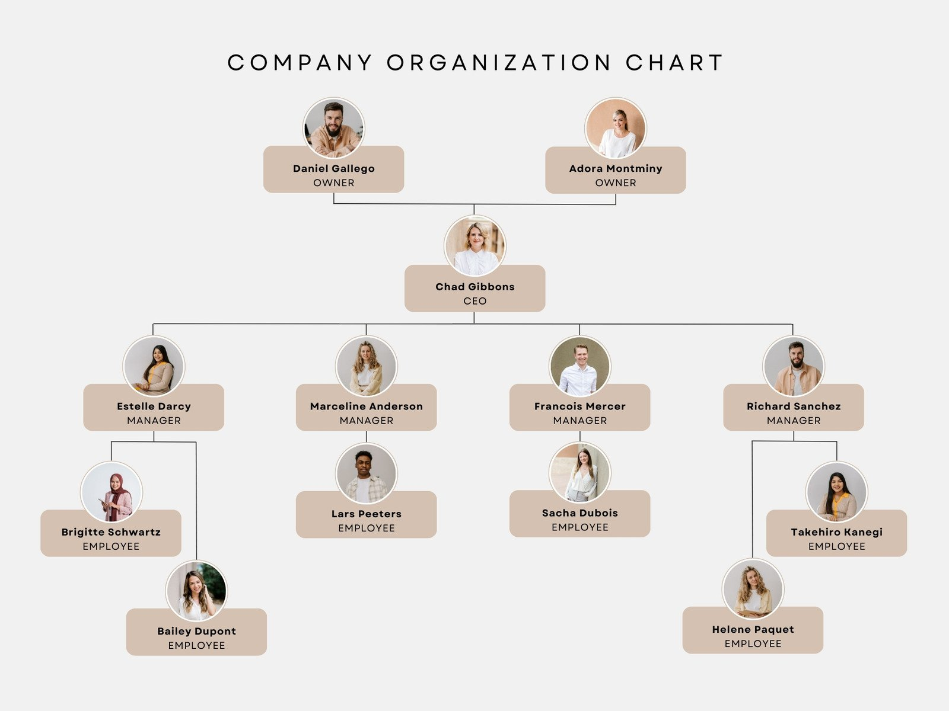
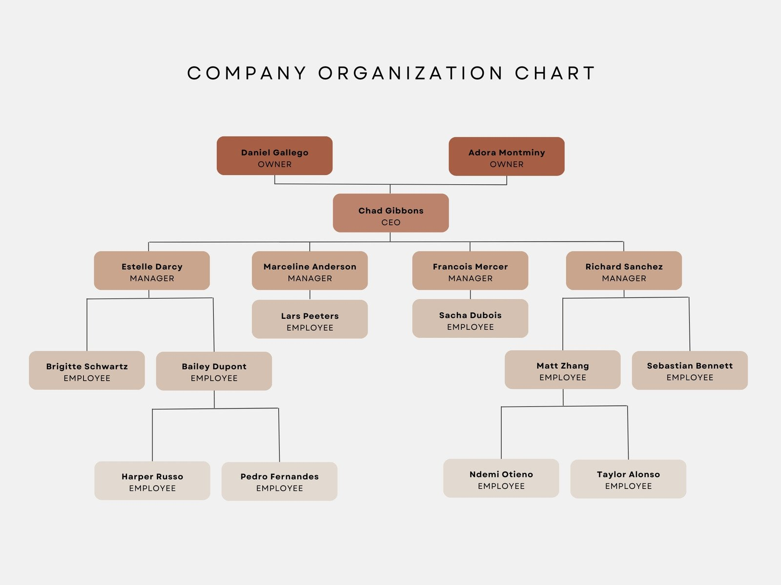
Who are the end users?

Slide 7
Our solution and it’s value proposition
Conditional formatting – missing
Filter – remove
Formula – performance level
Pivot- summary
Graph – data visualization

Slide 8
Dataset description
Employee dataset – edunet dashboard
26- features
9- features
Employee ID- numerical value
Name- text
Gender- text
Salary – numerical Value
Start date- numerical value

Slide 9
The “wow” In our solution
We are using this formula
IFS(Z8>=5,”VERY HIGH”,Z8>=4,”HIGH”,Z8>=3,”MED”,True,“low”)

Slide 10
Modelling
Data collection
Naan mudhalvan
Edunet dashboard
Feature selection
26 features
9 features
Data cleaning
Colour blank value
Filter – remove blank value

Slide 11
Salary level
Very High
High
Medium
Low
Pivot table
Employee ID
Name
Gender
Salary
Salary level
Start date
Employee type

Slide 12
Chart
Employee ID
Name
Gender
Salary
Salary level
Start date
Employee type
Data visualization

Slide 13
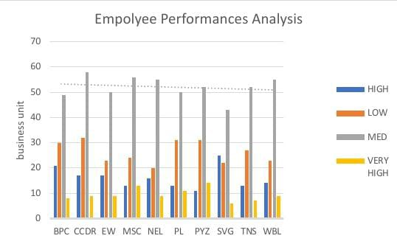
Result

Slide 14
Conclusion
While comparing the salary level of the employee the employee are getting their salary according to their employee type and start date.

